Slide 1
ITCS 3134
YIN HANG KWOK
E09 - Filter 02 (Median Filtering)

Slide 2
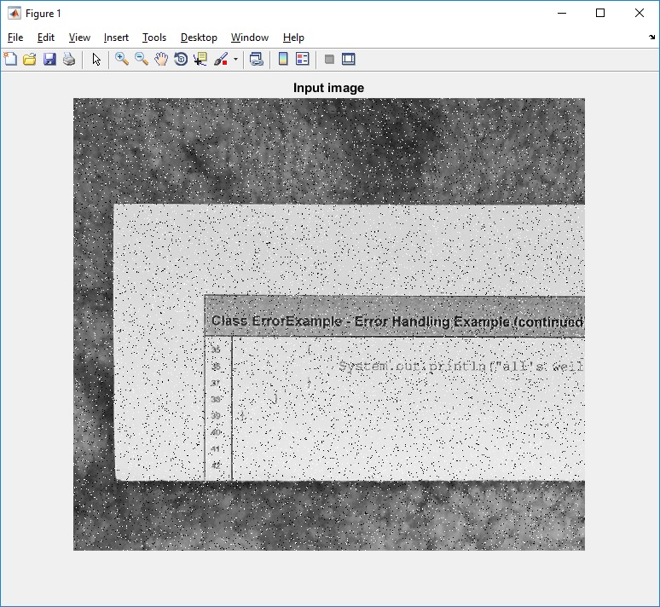
input image

Slide 3
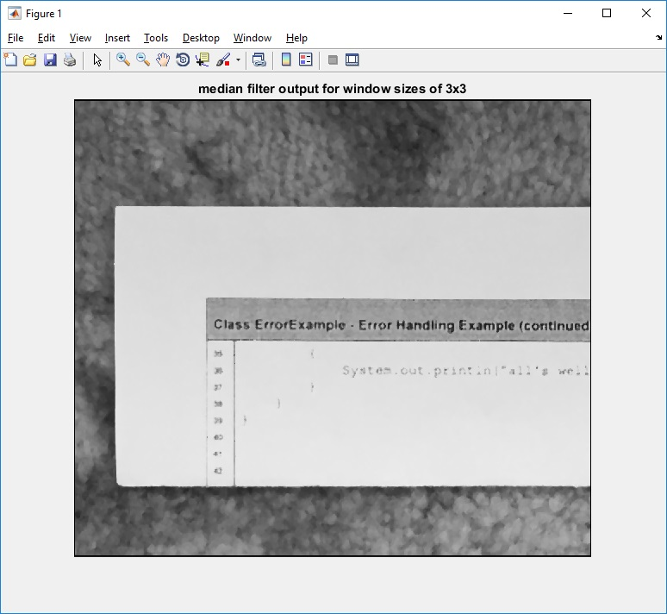
median filter output for window sizes of 3x3

Slide 4
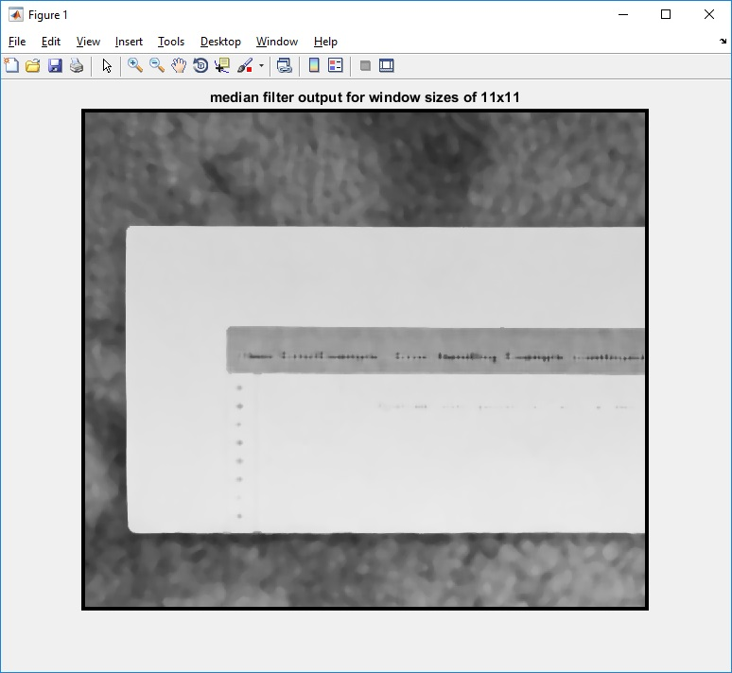
median filter output for window sizes of 11x11

Slide 5

median filter output for window sizes of 31x31

